Slide 1



Introduction to the Geomagic Touch haptic device and the relative software libraries
Faculty of Information Engineering, Computer Science and Statistics
M.Sc. in Artificial Intelligence and Robotics
AA 2016-2017
Professor:
Alessandro De Luca
Presenters:
Andrea Gigli, Irvin Aloise, Mirco Colosi

Slide 2
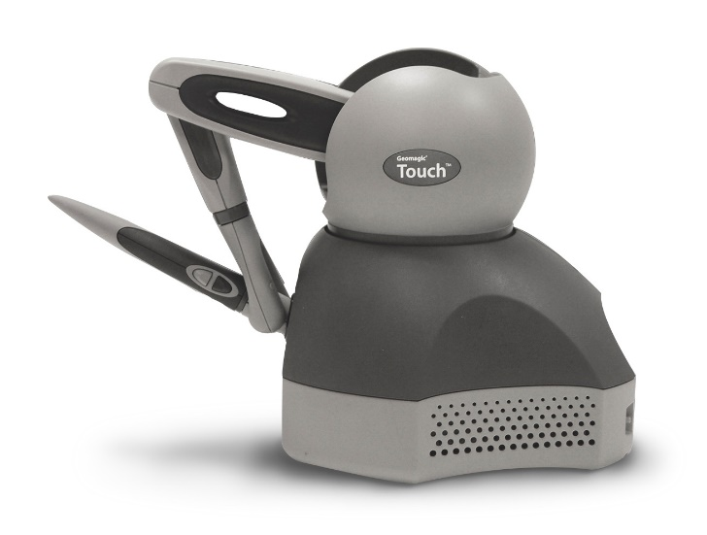
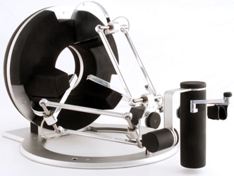
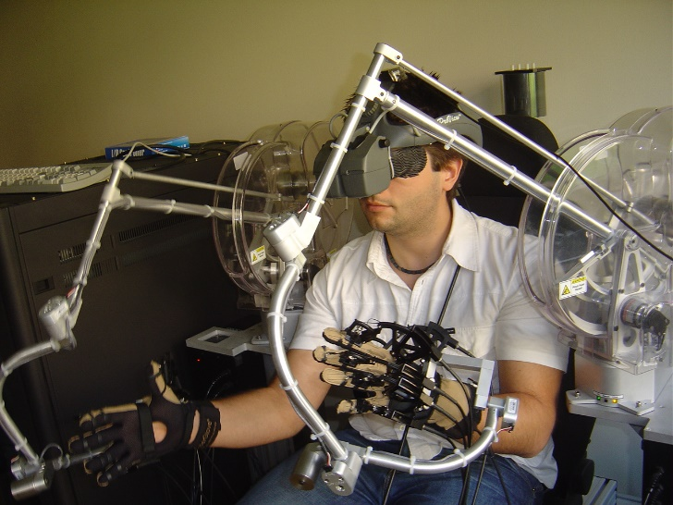
Haptic Interfaces
Robotic devices that allow physical interaction with a virtual environment or a teleoperated system.

Slide 3

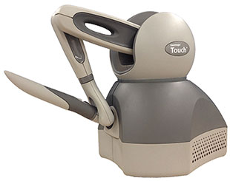
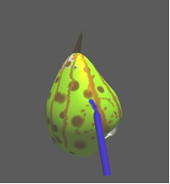
Haptic Rendering
Idea: HIP (Haptic Interface Point) coupled with a tool in virtual space. When the tool collides with a virtual object, the user feels an artificial reaction force.
VIRTUAL WORLD
Update
tool pos, detect collisions, compute reaction force
Move
Read HIP pos
Impose force
Send
Reaction force
Different kind of forces: Contact forces, Friction forces, Teleoperation forces, Effects..

Slide 4
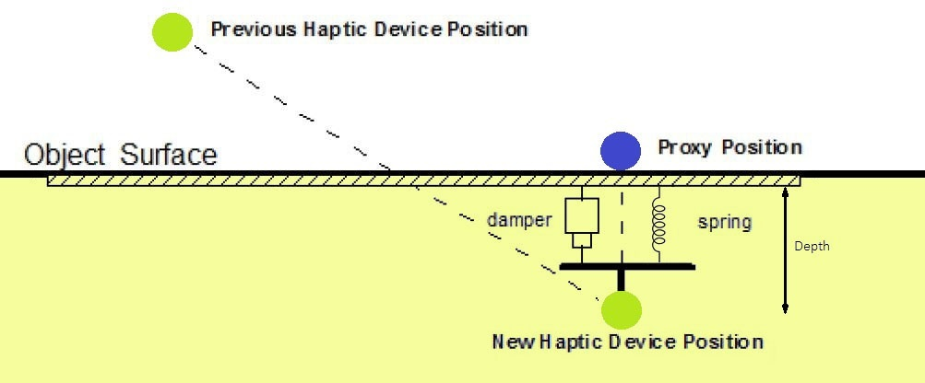

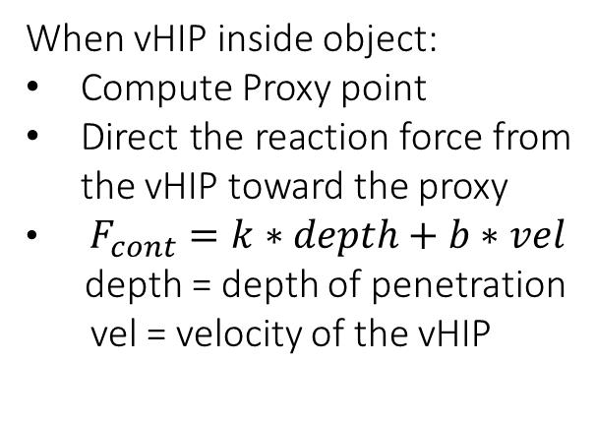
Contact Forces
Interaction between virtual HIP (vHIP) and virtual object = spring-damper system
When vHIP inside object:
Compute Proxy point
Direct the reaction force from the vHIP toward the proxy
$F_{cont}=k∗depth+b∗vel$
depth = depth of penetration
vel = velocity of the vHIP
$$F_{cont}$$
Example from OpenHaptics: ‘HapticMaterials’

Slide 5
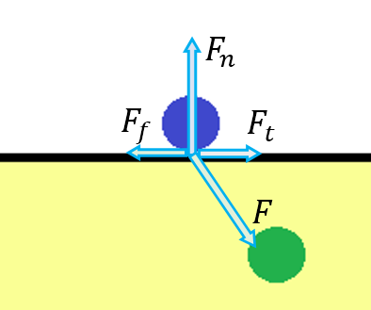
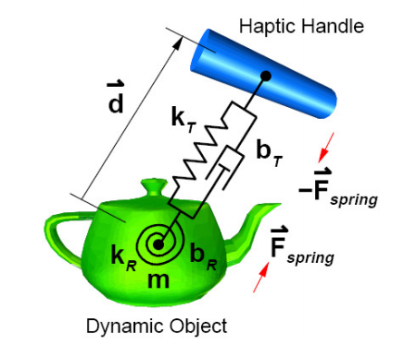
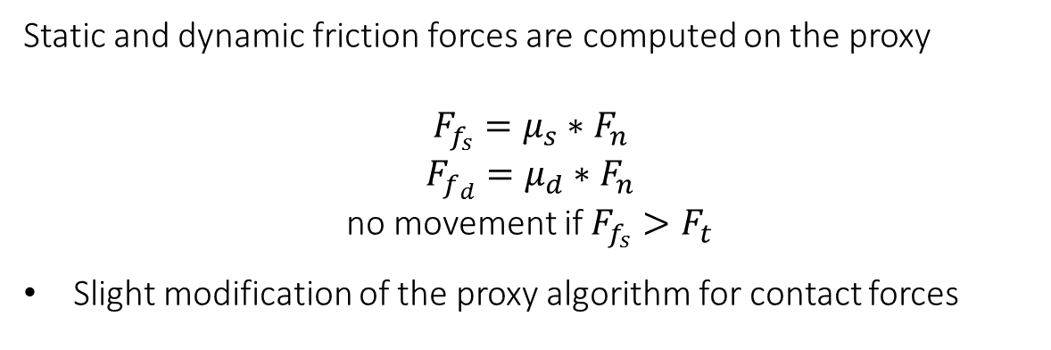
Friction Forces
Static and dynamic friction forces are computed on the proxy
$F_{f_{s}}=μ_{s}∗F_{n}$
$F_{f_{d}}=μ_{d}∗F_{n}$
no movement if $F_{f_{s}}>F_{t}$
Slight modification of the proxy algorithm for contact forces
Virtual coupling forces
“Feel” the inertia of a virtual body connected to the vHIP.
Typical of position/position teleoperation schemes.
Example from OpenHaptics: ‘SimpleRigidBodyDynamics’

Slide 6
Force Effects
Forces that arise from the movement in a portion of the virtual space.
Not linked to any virtual object.
Viscous friction
Stick-slip effect
Vibration
Example from CHAI3D: ‘Effects’
Constraints = Virtual Fixtures
Attractive/Repulsive forces that constraint the vHIP (then the HIP!) to a specific geometric region (dot, line, plane, surface) in the virtual environment.
Elastic/Magnetic attraction toward a constraint
Viscous friction in forbidden directions
Example from OpenHaptics: ‘Constraints’

Slide 7
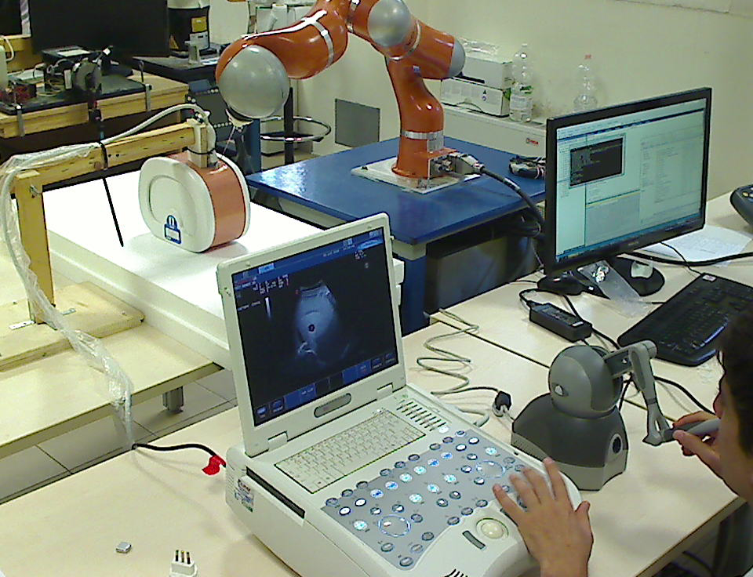
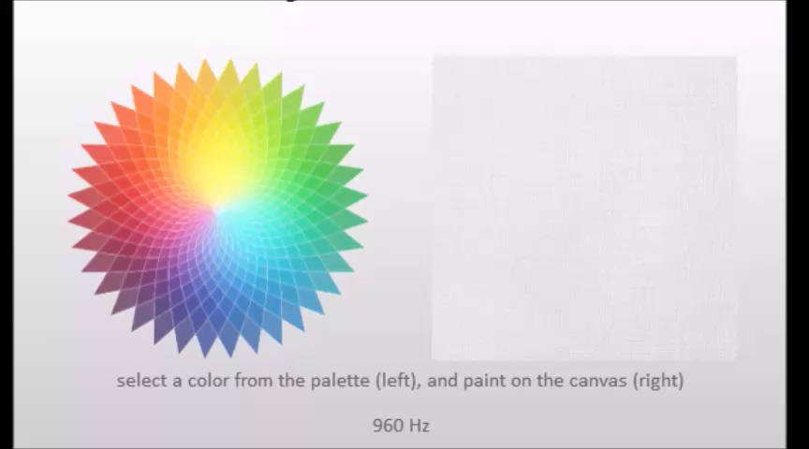
Applications of Haptic Interfaces
Touch surfaces
Manipulate objects (move, deform, decompose)
Create new objects (object carving, 3D painting)
Navigation in virtual environments
Teleoperation of virtual or real robots
Coordination of a team of robots
Examples from CHAI3D:
‘Textures’, ‘Magnets’, ‘Effects’,
‘Paint’ , ‘Map’ , ‘Object’ , ’Voxel’

Slide 8
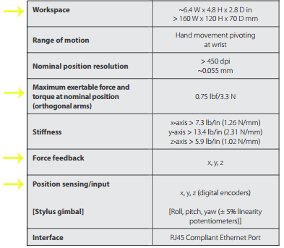
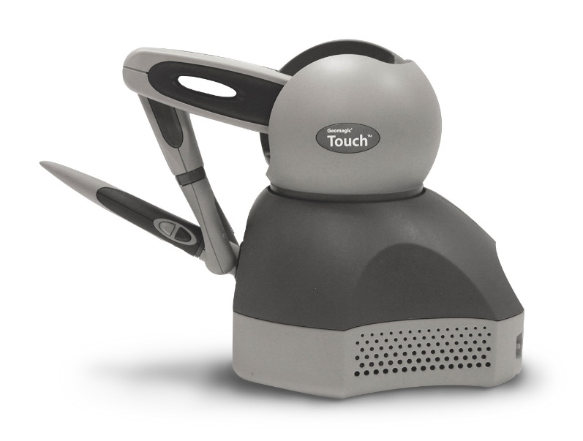
Geomagic Touch
Geomagic Touch by 3D System (previously called Phantom Omni by SensAble Technologies)
2 buttons
Compatible with OpenHaptics 3.4 and CHAI3D libraries.

Slide 9
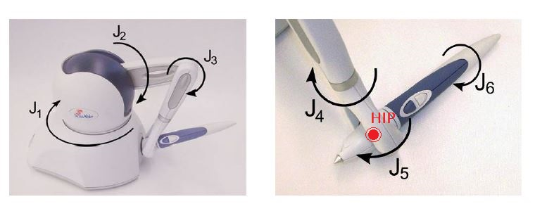
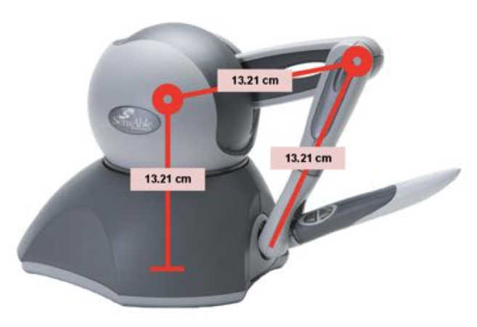
Geomagic Touch
First three joints
are actuated
Last three joints form a
passive spherical wrist
HIP (Haptic Interface Point) is the center of the spherical wrist

Slide 10
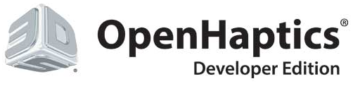
OpenHaptics Toolkit 3.4
Proprietary (3DSystems) C++ libraries that allow:
Interfacing with all the haptic devices of the Phantom family (by 3DSystems)
Development of software for interaction with a virtual environment through the interface
Integrated functions for graphic and haptic rendering of the virtual scene
3 groups of API from high-level to low-level: QuickHaptics, HLAPI, HDAPI
Quick haptics
Briefly: High-level API. Easy to use. User just has to define the shapes using given function. Graphic and haptic rendering managed by OpenHaptics.
What you can do with QuickHaptics:
Create simple shapes
Interact with the shapes graphically and haptically
Use pre-defined force effects
Define callbacks on contact event

Slide 11
Quick haptics (2)
What you are required to do:
Create a window where to graphically render the scene
Define the device space
Define the shapes and their properties
Define the cursor (collect informations about device and shapes)
What QuickHaptics will manage:
Insertion of many default parameters
Communication with the device
Graphic and haptic rendering
Collisions
Synchronization between graphic rendering loop (30Hz) and haptic rendering loop (1000Hz)
Disadvantages: API functions are very “closed”, you don’t have access to many informations and cannot perform complex tasks.

Slide 12
HLAPI (Haptic Library API)
Briefly: User has to define shapes and graphic rendering using OpenGL formalism. Haptic rendering managed by OpenHaptics.
What you can do with HLAPI:
Create complex graphic and haptic scene using OpenGL formalism
Define custom callbacks for a set of events
Define constraints (virtual fixtures)
What you are required to do:
Define shapes using openGL formalism (vertices, edges, transformations, material properties). The physical properties are treated as classical OpenGl properties
What HLAPI will manage:
HLAPI uses graphic informations to compute collisions and haptic rendering
Communication with the device
Synchronization of graphic and haptic rendering

Slide 13
HDAPI (Haptic Device API)
Briefly: Low-level API. Difficult to use. User must define shapes, graphic rendering (OpenGL) and also collisions and haptic rendering. You can do a lot but not everything works as expected..
What you can do with HDAPI:
Directly impose custom forces to the device
Read low-level sensor data from the device (joint velocities, torques)
Define custom haptic rendering and collision detection algorithms
Define custom effects
What you are required to do:
Separately define functions for graphics rendering, collision detection and haptic rendering
Use efficient collision detection and haptic rendering algorithms (they run once for every haptic loop iteration)
Manage the synchronization of the graphic loop (30Hz) and the haptic loop (1000Hz)
What HDAPI will manage:
Initialization and communication with the device

Slide 14
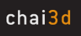
CHAI3D (Computer Haptics and Active Interface)
Open-source multi-platform set of C++ libraries for haptics and visualization
Released in 2004 by AI Lab at Stanford University + EPFL + University of Siena
Features:
Allows communication with several haptic devices (both 3 and 6 dof)
Manages graphic and haptic rendering. Has its own graphic engine (OpenGL based), provides multiple collision detection and force rendering algorithms
Allow to read/impose values to/from the haptic device
Has a clear documentation
Provides integration modules for third party softwares like V-REP

Slide 15
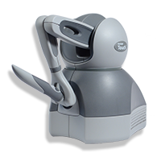
Interaction scheme between CHAI3D and V-REP
External C++ plugin
CHAI3D
DEVICE
V-REP
Haptic loop
Other C++ libraries
V-REP
simulation loop
V-REP Scene
User’s code
goes here

Slide 16
System Setting
Besides the device is recognized both in Windows and Ubuntu, the following procedure has been used and tested on Windows 10 only.
The following procedure is explained in detail in the appendix guide.
Download and install Geomagic touch drivers
Download and install OpenHaptics or CHAI3D libraries
Both libraries require Microsoft Visual Studio
Note about the structure of the folders of OpenHaptics and CHAI3D (bin, doc, examples)
Do the pairing and calibration procedure (Geomagic Driver)
Run the compiled program and have fun

Slide 17
Thanks for your attention

Slide 18
APPENDIX:
Guide to installation of Geomagic driver, OpenHaptics and CHAI3D
Notes:
Besides the device is recognized both in Windows and Ubuntu, the following procedure has been used and tested on Windows 10 only.
OpenHaptics requires Microsoft Visual Studio 2005/2008/2010, while CHAI3D requires Microsoft Visual Studio 2012/2013/2015.
INSTALLATION OF GEOMAGIC DRIVER AND OPENHAPTICS
From https://3dsystems.teamplatform.com/pages/102774?t=r4nk8zvqwa91 download the Geomagic touch driver for windows ‘Geomagic_Touch_Device_Driver_2016.1.1.exe’ and the OpenHaptics v3.4 ‘OpenHaptics_Developer_Edition_v3.4.0.zip’
Install the Geomagic touch driver using the install (.exe)
Install the OpenHaptics using the install (.exe)

Slide 19
Guide to installation of Geomagic driver, OpenHaptics and CHAI3D
INSTALLATION OF CHAI3D
Note: CHAI3D requires Geomagic drivers but not nevessarily OpenHaptics. To use chai3d module for V-REP you need V-REP already installed in your computer (download from here http://www.coppeliarobotics.com/downloads.html).
From http://www.chai3d.org/download/releases download the ‘Multiplatform (Windows / Linux/ Mac OS X)’ version of CHAI3D
CHAI3D does not require installation, then unzip the archive in the location where you want the main folder of CHAI3D to be (e.g. ‘C:\’)
In the ‘doc’ folder you will find the documentation of CHAI3D. Please open ‘getting-started.html’ and select ‘on Windows visual studio’ to get the instructions to compile the CHAI3D examples. The ‘root folder’ mentioned in the instruction is the folder ‘chai3d-3.1.1’ which contains all the other chai3d folders (included ‘doc’).
In the same way you can compile the examples relative to the external modules (eg V-REP). For V-REP, go in ‘chai3d-3.1.1/modules/V-REP/doc/getting-started’ and follow the instructions to compile the chai3d-vrep examples (similar to point 3).

Slide 20
Interface the device with pc, use OpenHaptics and CHAI3D
CONNECT THE DEVICE TO THE PC:
Connect the device Ethernet port 1 with the Ethernet port of the pc
In the installation directory of Geomagic DRIVERS (usually ‘programs\3DSystems\Geomagic’…) launch ‘Geomagic_Touch_Setup.exe’. Select ‘Geomagic Touch’ under the ‘Device Model’ box, click ‘pairing’ and fastly press the button on the back of the Geomagic Touch. Click ‘apply’ and exit.
In the installation directory of Geomagic DRIVERS (usually ‘programs\3DSystems\Geomagic’…) launch ‘Geomagic_Touch_Diagnostic.exe’, click on the right arrow which is at the bottom-right of the window, until you arrive at the ‘Calibration’ page. Wait for the ‘Calibrate’ button to become green (or force calibration by clicking on it).
In case of ‘communication error’ please disconnect the Ethernet cable and repeat the procedure from point 2
WORK WITH OPENHAPTICS:
The reference folder usually is ‘C:\OpenHaptics\Developer\3.4.0’ . In this folder you can find the documentation (‘docs’) and useful examples (‘examples’).

Slide 21
Interface the device with pc, use OpenHaptics and CHAI3D
The examples’ binaries are contained in ‘examples\bin’ , while the sources are in ‘examples\HL’ and ‘examples\HD’.
Use Visual studio 2005, 2008, 2010 to open an example project (e.g. use Visual Studio 2010 to open the file ’examples\HL\graphics\Events\Events_VS2010.vcxproj’)
If you modify and compile the previous example for x64 systems, the generated binary program will be saved in examples\HL\bin\x64\HL\.
A good way to start using OpenHaptics is to create a copy of an example folder (in the ‘examples’ folder itself!!!), modify the example with Visual Studio, compile and see what happens..
WORK WITH CHAI3D
The root folder usually is ‘chai3d-3.1.1’ that you have extracted from the archive during the installation of CHAI3D. In this folder you can find the documentation (‘docs’), useful examples (‘example’) and the binaries of the compiled examples (‘bin’).
As before use Visual Studio 2012/2013/2015 to open an example project, modify it, and compile it. The binaries will be saved in ‘chai3d-3.1.1\bin’.

